Slide 1

BBC News Article Classification Using Machine Learning
Name : Dhanesh Kanakaraj
Student ID : 23056970
Supervised by : Dr. Stephen Kane
GitHub Link : https://github.com/kdhanesh619/Final-Project.git

Slide 2

Introduction
In today's information-saturated digital landscape, news organizations face the mounting challenge of efficiently categorizing vast quantities of articles.
Manual tagging processes are unsustainable and inconsistent
Natural Language Processing offers scalable, automated solutions
This project applies supervised learning to classify BBC news articles by topic

Slide 3




Research Question
Can machine learning models accurately classify BBC news articles into predefined categories?
Primary Objective
Develop high-accuracy classification models using Term Frequency-Inverse Document Frequency (TF-IDF) features
Secondary Objective
Evaluate and compare performance across multiple supervised learning algorithms
Knowledge Contribution
Identify optimal model architectures for news classification tasks

Slide 4
Literature Review
1
Joachims, T. (1998). Text categorization with support vector machines: Learning with many relevant features. ECML.
➤ Introduced SVM for text, emphasizing high-dimensional sparsity handling.
Scikit-learn Documentation (2023). Logistic Regression & GridSearchCV.
➤ Practical references for applying machine learning to real-world classification.
2
Ramos, J. (2003). Using TF-IDF to determine word relevance in document queries.
➤ Core study establishing TF-IDF as a standard for word relevance in NLP.
3

Slide 5

Dataset Description
2,225
5
Total Articles
Categories
A diverse range of BBC articles representing real-world news reporting
Business, Politics, Sport, Entertainment, Tech
The BBC News Article Dataset is publicly available and contains no personal or private information, ensuring ethical compliance in research usage.
The dataset was compiled by the University College Dublin (UCD) Machine Learning Group. The articles were collected from the BBC News website around 2004–2005. The data is organized into folders by category.

Slide 6
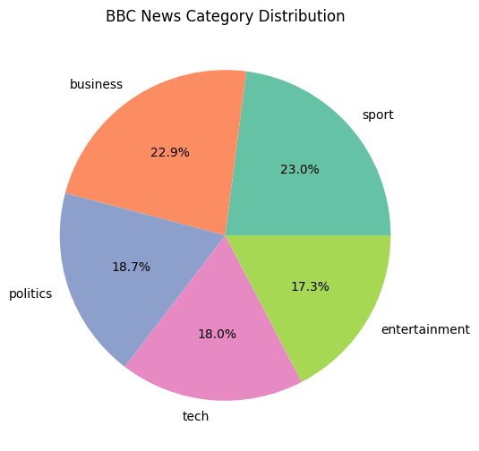
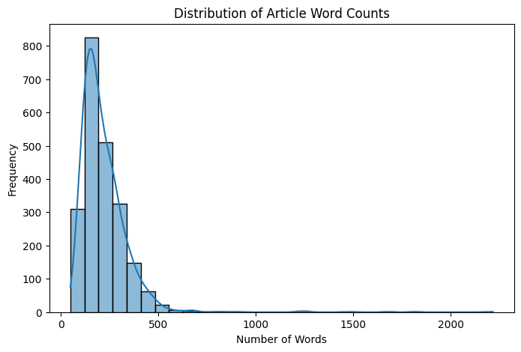
Feature Analysis – Top Words

Slide 7

Preprocessing Pipeline
Text Normalization
Converting all text to lowercase and removing digits and punctuation to standardize input format
Noise Reduction
Eliminating common stopwords (e.g., 'the', 'is', 'and') that add little semantic value
Lemmatization
Reducing words to their base forms (e.g., 'running' → 'run') to unify different word forms
Vectorization
Transforming text into numerical features using TF-IDF with the top 5,000 features

Slide 8

Methodology – Model Selection
Models Implemented
1
Logistic Regression
Linear model with probabilistic output, efficient for text classification
2
Support Vector Machine (LinearSVC)
Maximum margin classifier, effective with high-dimensional data
3
Multinomial Naive Bayes
Probabilistic classifier designed for text, assumes feature independence
Evaluation Framework
All models assessed using stratified 5-fold cross-validation with metrics including accuracy, precision, recall, and F1-score
4
Random Forest
Ensemble of decision trees, reduces overfitting through voting

Slide 9








Model Optimization Strategy
Tuned Parameters
GridSearchCV
Regularization strength (C): 0.1, 1, 10
Exhaustive search through specified parameter space to find optimal configuration
Solvers: 'liblinear', 'lbfgs'
Class weights: balanced, none
Optimal Configuration
Validation Protocol
Logistic Regression with C=1, solver='liblinear', class_weight=None
3-fold cross-validation within training set to prevent overfitting

Slide 10
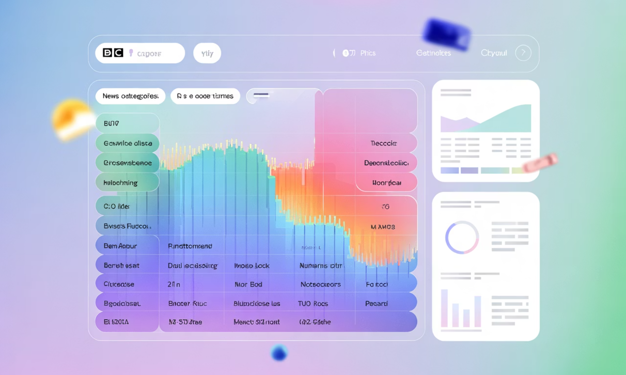
Evaluation Metrics
Performance Analysis
All models demonstrated strong performance above 95% accuracy
Confusion matrices revealed minimal misclassification between categories
Precision and recall metrics showed balanced performance across all news topics

Slide 11
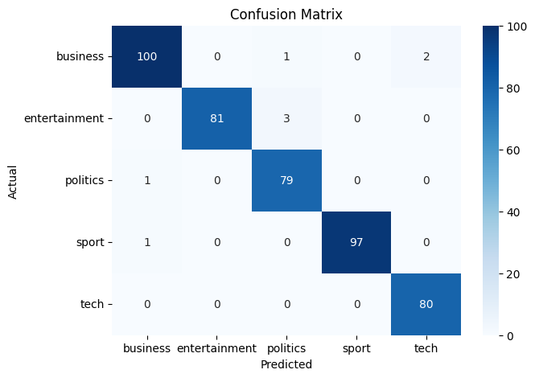
Confusion Matrix – Logistic Regression

Slide 12

Best Model: Logistic Regression
Superior Accuracy
Achieved 98% classification accuracy, outperforming other models in the comparison
Feature Compatibility
Efficiently handles sparse, high-dimensional TF-IDF feature vectors characteristic of text data
Computational Efficiency
Fast training and prediction times make it suitable for real-time news classification systems
Interpretability
Provides interpretable feature coefficients that reveal word importance in classification decisions

Slide 13
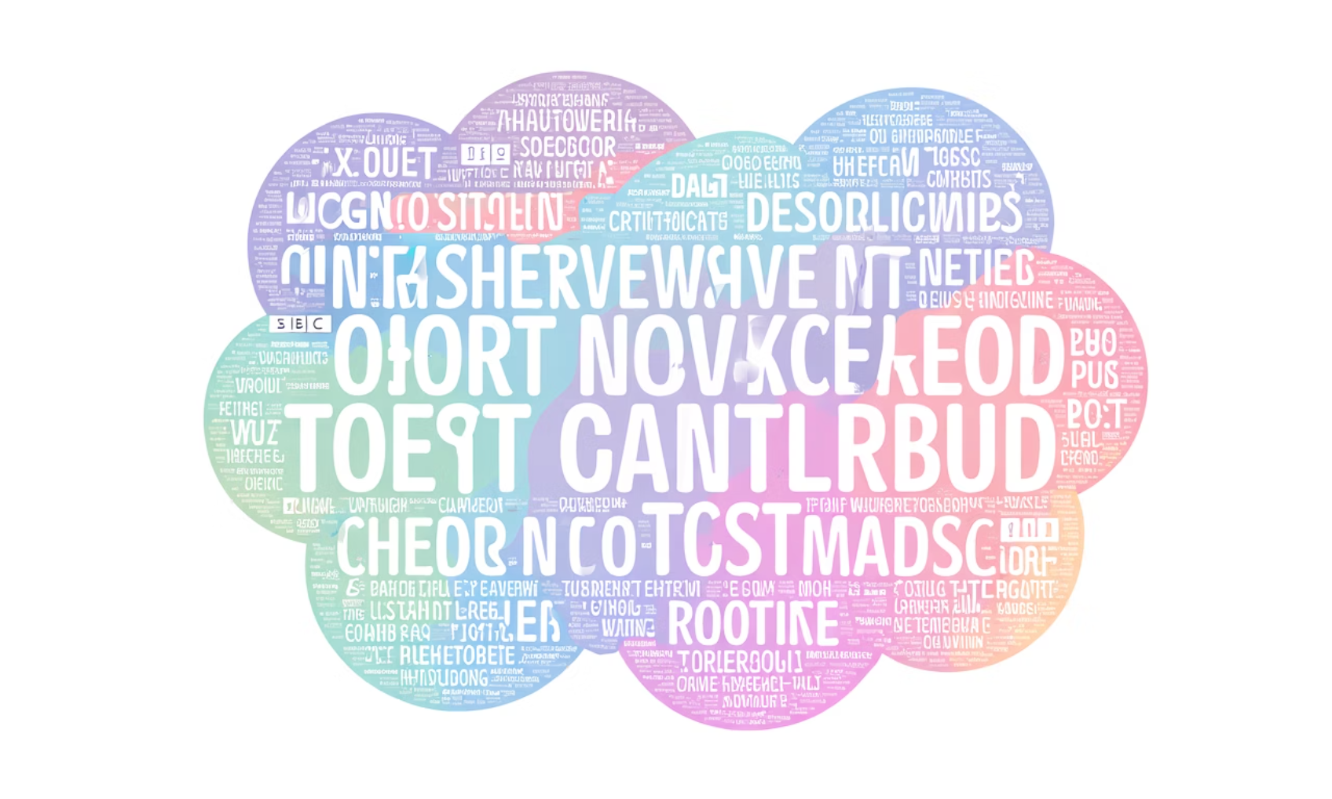
Feature Analysis Insights
Top Predictive Words By Category
Sport
football, goal, match, player, team, coach, league, club, score, championship
Business
market, shares, profit, economy, investment, stock, financial, growth, company, trade
Technology
software, device, digital, internet, computer, mobile, app, innovation, technology, data
Politics
government, election, policy, minister, vote, parliament, campaign, party, debate, law
The model's feature importance analysis confirms it has successfully learned contextually relevant vocabulary for each news category, validating the effectiveness of the TF-IDF approach.
Entertainment
film, music, award, actor, movie, album, celebrity, director, performance, star

